Slide 1
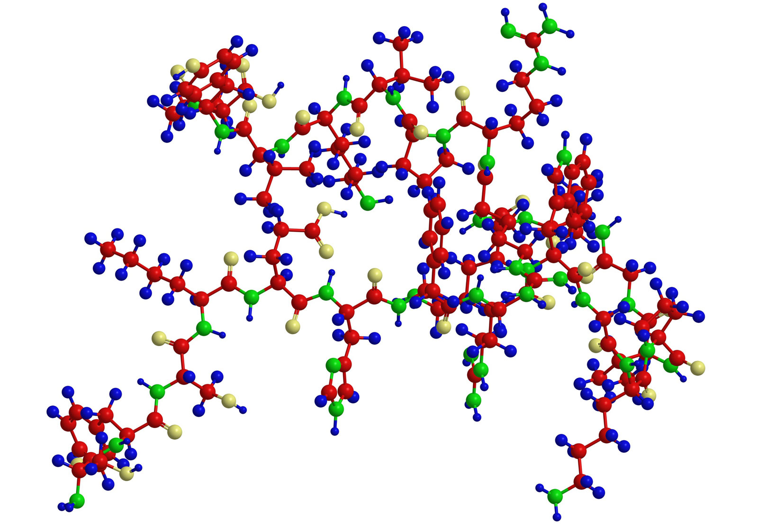
Can we improve cancer patient’s response to available drugs by identifying the important proteins?
Team Members : Behnam Barbadi , Binny Chauhan, Ritu Ranjani Ravi Shankar, Stuti Sanghavi, Tanmayi Varanasi

Slide 2

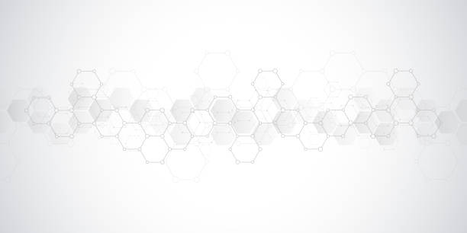




Agenda
01
Problem Statement
02
Dataset Overview
Agenda
03
Why use text data?
04
RNN and CNN models using Prot2Vec
05
Important Protein Identification
06
Learnings and next steps

Slide 3
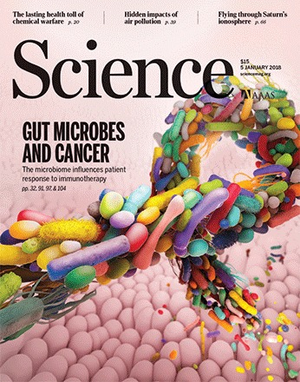

Project Ideation

Slide 4
What is this project about?
At the lab, the stool samples for gut cancer patients are examined for extracting BGC
BGC is divided into pfams (protein families), which become the features of our data
So if we get pfams, we can re-create a list of BGC
Patients that have BGC’s are responders to the drugs
Extracting BGC
Getting pfams
Recreating BGC’s
Identifying responders
Notes:
Data is specially for company
They have a contract with the hospital and patients. For gut cancer, they check the poop sample at the hospital and they extract the BGC (BGC -- organized group of genes involved in production of metebolitis) out of the poop sample at the lab.
BGC is like the blue print for the protein.
BGC is divided into pfams (protein families), these phams are the features of our data.
What matters at the end is what BGC is created by the phams. If we get a list of pfams, we can re create the list of BGC. And those patients that have the BGC’s are responders to the drugs.

Slide 5
Problem Statement
30%
Patients responsive
Why only 30%?
Proteins play an important role
.
Only few patients in stage 3 or 4 of cancer respond to drugs
Our goal is to find the reason behind this low response rate
Hence we want to identify the key proteins
Notes:
Research shows that only 30% of the patients in stage 3 or 4 of gut cancer respond to current drugs and there are certain proteins responsible for these patients being responsive. So, our Goal is to find the reason behind this low response rate and identify the important proteins.

Slide 6
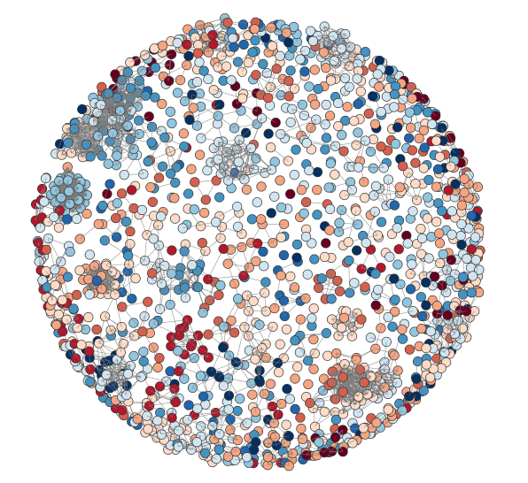
Graph Theory
Notes:
So the red dots represent protein samples of non responders and blue ones indicate protein samples of responders.
We also see clusters of proteins together indicating that those proteins often occur together

Slide 7



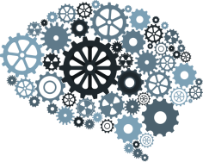


NLP Techniques used
Topic Modeling
01
Tf - idf vectorizer
03
02
Word2Vec
SHAP and Captum
04

Slide 8
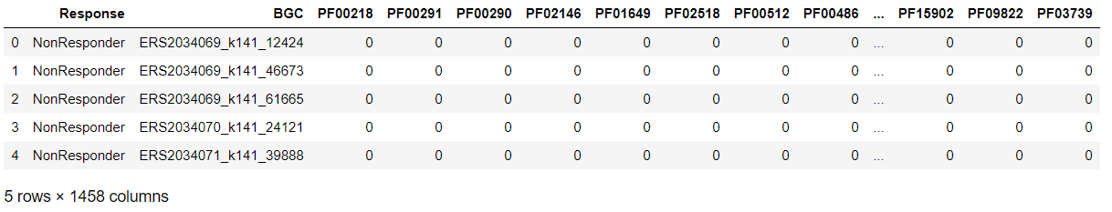
Dataset
Label | Count
Responder | 106
Non Responder | 338
Notes:
Tabular dataset indicating the sequence of proteins as 1s, if present and 0s, otherwise.
The dataset is comprised of few hundred rows which represent patients and few thousand columns representing all the proteins found in the bacteria inside all patients' gut. But each patient has only a small portion of these proteins. For example, if we have 3000 proteins in total, each patient approximately has 100 of these proteins. So, we have a dataset which has only a few 1s and many 0s.

Slide 9
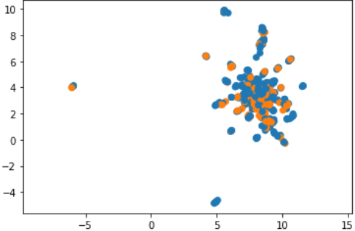
UMAP of the Protein dataset
Notes:
Uniform Manifold Approximation and Projection
UMAP is a nonlinear dimensionality reduction method, it is very effective for visualizing clusters or groups of data points and their relative proximities
Here our tabular dataset has around 1456 distinct proteins. It is very difficult to have a visualization for each protein, hence we use UMAP to see if there are any clusters formed for responders and nonresponders. We see that there is no simple way of using these proteins to differentiate between the two since there is an overlap.

Slide 10
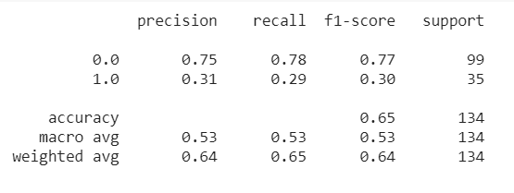
Linear Model
Data Loading & Preprocessing
Linear Model
Model Evaluation
3 Linear layers of sizes 1456, 256, 64
Relu Activation function
Dropout layer with p=0.1 before the last layer
Sigmoid activation function for the output layer
BinaryCrossEntropy loss
Adam Optimizer
Learning rate 0.001
Notes:
We used the tabular data to see if the model is able to predict the labels correctly. Ran a linear model with dense feed forward network in pytorch.
Talk about the results.

Slide 11
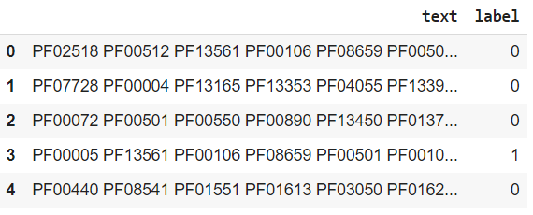
Tabular to Text

Slide 12




Why use text data
Each patient has only small portion of all possible proteins and we have around 1456 proteins available
This results in a high dimensional dataset
To tackle this, we convert tabular data to text data to treat it as an NLP problem
We referred to the paper, continuous distributed representation of protein sequences
Notes:
Our dataset is comprised of few hundred rows which represent patients and few thousand columns representing all the proteins found in the bacteria inside all patients' gut. But each patient has only a small portion of these proteins. For example, if we have 3000 proteins in total, each patient approximately has 100 of these proteins. So, we have a dataset which has only a few 1s and many 0s. We have a lot of protein data available and not all patients are having all the proteins
To reduce the dimensions, we did a tabular to text data conversion. We got this inspiration from this paper continuous distributed representation of protein sequences, to convert the tabular data into a text data and use NLP techniques on them for classification.
Unlike most NLP project, in this project we don’t work directly with text, instead we take a reverse engineering approach and turn a tabular dataset into a text file so it can be treated with NLP techniques.
And that’s where NLP comes to the picture.

Slide 13
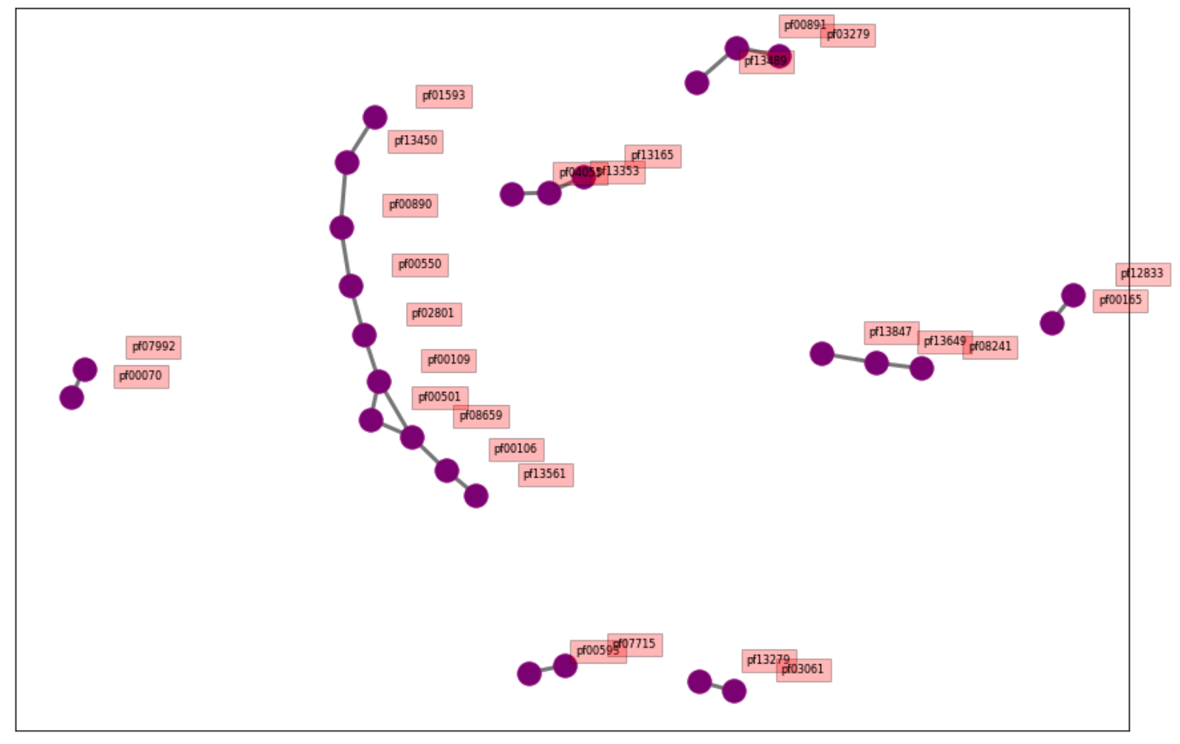
Bigrams for Protein Network
Notes:
This is a bigram for top 20 proteins that commonly occur together
Proteins on their own have no meaning, but they become meaningful when they are in a sequence.
Through this plot we can see the relationship between the proteins and how they are connected.

Slide 14
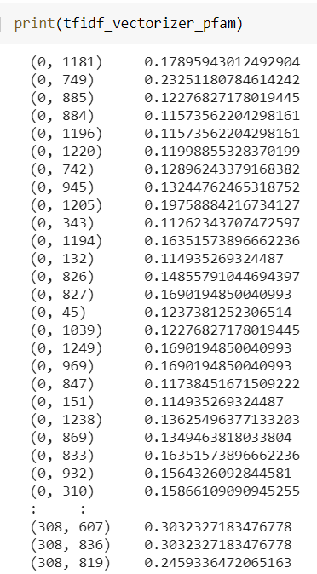
Linear feed forward model with tf - idf vectorizer
Data Loading & Preprocessing
Tf - idf vectorization
Linear Model
Model Evaluation
0.74 accuracy on evaluation set
Converting tabular data into text files
Creating a corpus
4 Linear layers of sizes 1258, 512, 256, 64
Relu Activation function
Dropout layer with p=0.1 before the last layer
Sigmoid activation function for the output layer
BinaryCrossEntropy loss
Adam Optimizer
Learning rate 0.001
Notes:
We do this to see how well our model performs on a text data. We do tf-idf like all other conventional NLP problems.
Talk about converting all the proteins into bigrams etc and talk about word embedding (what happen if the proteins are similar in space?)
Explain if we have done anything out of the box in the models/programming(like building our own positive and negative samples) etc.
We ran an RNN assuming our proteins are in sequences, but we don’t have that info coz if the lab technitian doesn’t extract the protein properly, then it might give us a different result. So it depends on how the protein is extracted. We anyway went ahead with RNN.

Slide 15
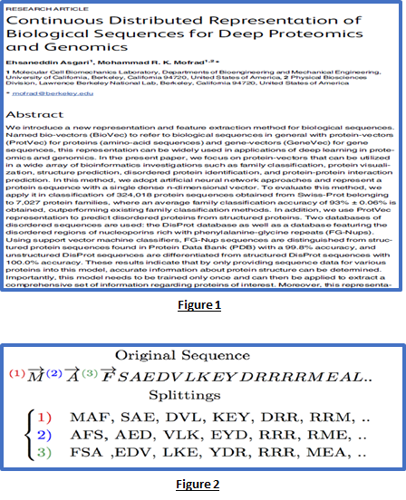
Prot2Vec
Approach:
Use neural network to represent protein sequence with a single N dimensional vector
Split the protein sequence in group of 3 (3-grams) and create a corpus
Create a set of (word, context) pairs
Randomly generate negative samples (pair of incorrect word and context)
Train the data using Skip gram neural network with a vector size of 100
Application:
Protein visualization
Protein family classification
Structure prediction
Domain extraction
Interaction prediction

Slide 16
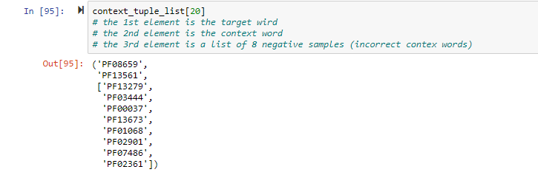
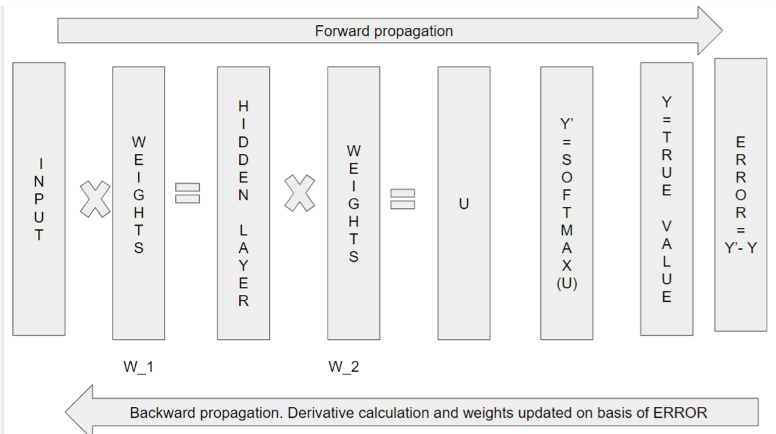
Embedding for proteins
Instead of 3-grams we work with Unigrams (single PFAM)
We create list of target, context and 8 negative samples
Corpus contains 80277 such pairs which is passed to Skip gram neural net
Model contains only 1 hidden layer
Weights are assigned to Input and hidden layer
Error calculated after 1st pass is back propagated to update weights for next iteration
Repeat process for specified iteration or until desired loss is achieved
Notes:
We start by implementing Pro2Vec to create embedding weights for RNN model
Our pfams are actually a tuple of different Proteins (protein family of proteins that occurs together) like the approach that the paper took.
Protein2Vec model: trained with window size of 4 and early stopping with minimum percentage of of 0.5%. Inputs of context, target and 8 negative samples. Outputs are vectors of size 200. Trained with CrossEntropyLoss and Adam optimizer with learning rate of 0.001
These embeddings run an RNN over all proteins in a pfam and use the final state of the RNN as embedding for the whole document.
This will output a single embedding for the complete sentence. The embedding dimensionality depends on the number of hidden states you are using and whether the RNN is bidirectional or not.
When working with text, the first thing you must do is come up with a strategy to convert strings to numbers (or to "vectorize" the text) before feeding it to the model.

Slide 17
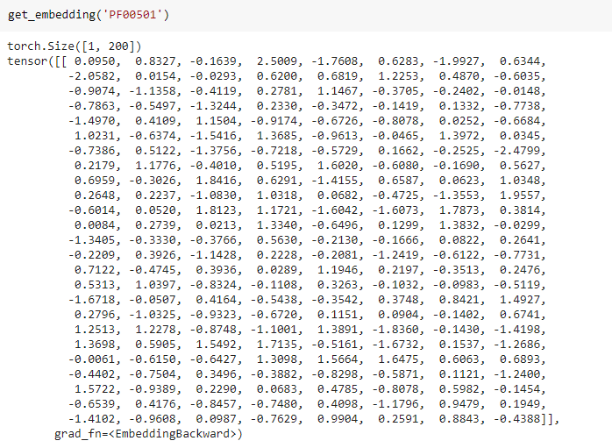
Embedding for proteins
The embedding output is a vector of size 200 for each PFAM
Notes:
We start by implementing Pro2Vec to create embedding weights for RNN model
These embeddings run an RNN over all proteins in a pfam and use the final state of the RNN as embedding for the whole document.
This will output a single embedding for the complete sentence. The embedding dimensionality depends on the number of hidden states you are using and whether the RNN is bidirectional or not.
When working with text, the first thing you must do is come up with a strategy to convert strings to numbers (or to "vectorize" the text) before feeding it to the model.

Slide 18
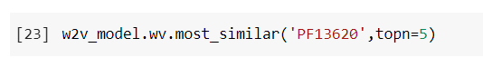
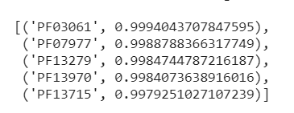
Similar proteins in embedding space

Slide 19
RNN model with Prot2Vec
Data Loading & Preprocessing
Prot2Vec
RNN Model
Model Evaluation
0.76 accuracy on evaluation set
Create a vocabulary for PFAMS
Split dataset into Training and Test set
Load the embedding weight from Prot2Vec and pass its as 1st layer in RNN model
Create RNN model with:
Prot2VecEmbedding layer
2 GRU layer
Fully connected linear layer
Loss function = Logit loss
Optimizer = Adam
Notes:
Converting all the proteins into a skip gram, bigrams and you have word embedding (if proteins are similar then..)
Created some positive and negative samples.
We ran an RNN model on the pretrained embedded weights assuming our proteins are in sequence. But, we don’t know if the proteins are sequential. So, if the lab technician is not extracting the proteins properly, we might have different results.
Note : Explain if anything outstanding in the code used

Slide 20
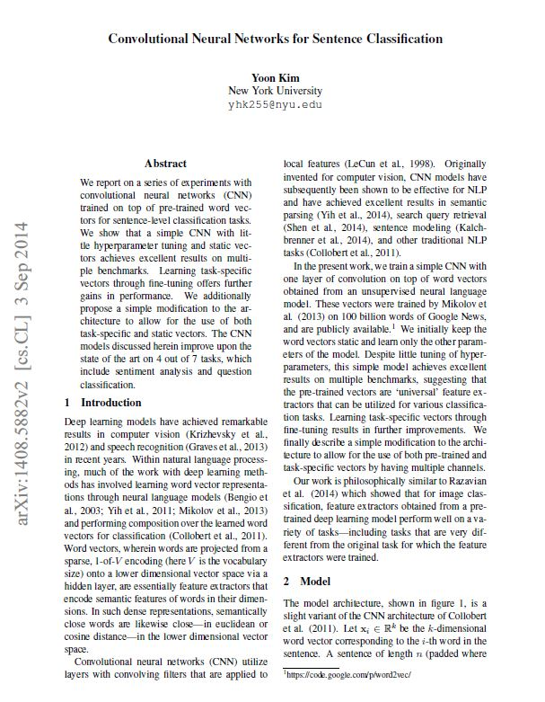
Convolutional Neural Networks for Sentence Classification
CNNs are generally used in computer vision, however for various NLP tasks they’ve shown promising results.
Conv layers are able to pick out features (sequences of tokens) in a way that is invariant to their position within the input sequences.
learned filters in the first layer are capturing bigrams.
Notes:
Yoon Kim, 2014
Detect patterns in different places of an image not related to each other
CNN filters like Sobel and Laplacian

Slide 21
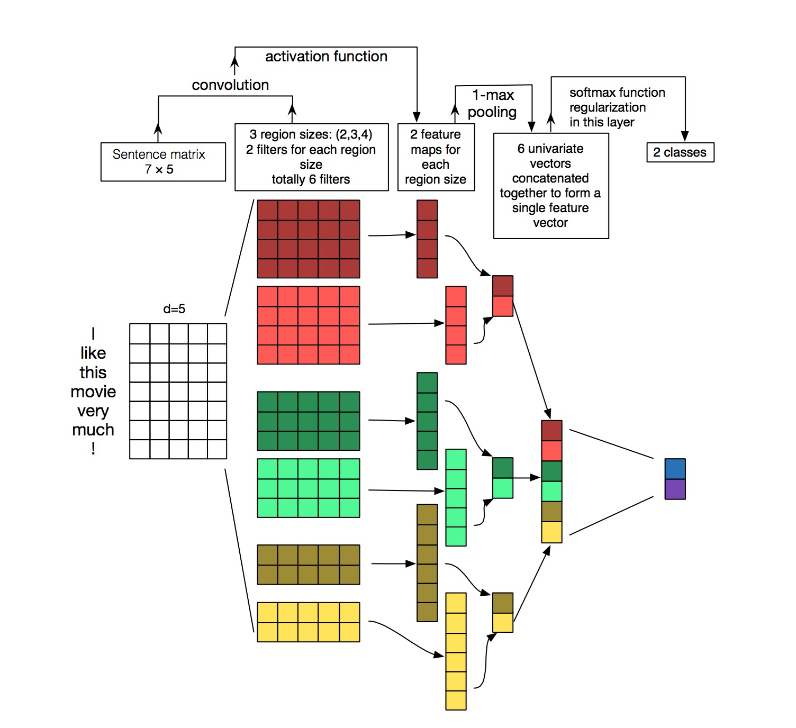
CNN Model
Model Architecture:
CNN using the same Protein2Vec embedding weights calculated in before..
All BGSs converted into vectors of size 121(equal to the highest number of pfams found in a BGC).
We have 4 Convolution layer each has 10 kernels of sizes 1,2,3,5 and length of the ebbedding. These are followed by Maxpool1D after each convolutional Layer.
All vectors concatenated to form the final input to the feed forward layer
Notes:
Input = [ batch_size, channels, width, height ]
here: [ batch_size, 1, sent_length=121, embedding_size=200 ]

Slide 22
CNN model with Prot2Vec
fsdfsfdsdf
Data preprocessing
Prot2Vec Embeddings
CNN Model
Model Evaluation
0.79 accuracy on evaluation set
Tokenized
All rows to the same length of 121
Our own modified word2vec
Gensim word2vec
1st layer is the prot2vec embeddings 1, 2, 4, 5
4 Conv2D layers with 10 filters of 4 kernel sizes
Relu Activation Function
Maxpool1d
Fully Connected Layer
BinaryCrossEntropy loss
Adam Optimizer
Learning rate 0.001
Notes:
We tokenized the pfams using texthero, to get a list of separate proteins
To train the protein vectors we use Prot2vec using gensim because our model did not show good results when only Pro2Vec was used.

Slide 23
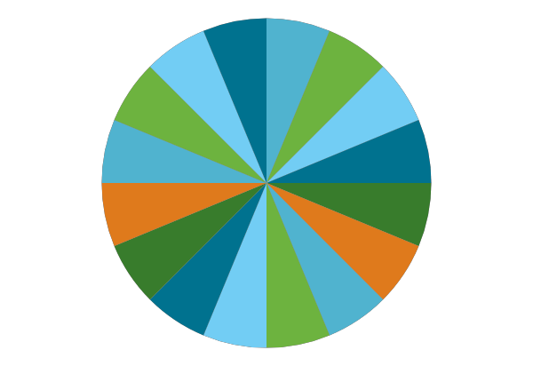

AutoGluon
Xgboost
1
2
Lightgbm
3
Random forest
4
Neural Net Classifier
Notes:
Since, we didn’t get good output from the other models, we try to input the data in a pretrained model.
It is an Open source AutoML library
Automates DL and ML for real world application containing Image, Text and Tabular data
For this project, we used it on the text data
AutoGluon is like a blackbox. It runs on pretrained models and finds the strongest ML methods within its allotted run-time.
In our case, we decided to go ahead with Xgboost and use SHAP to identify the important proteins.

Slide 24
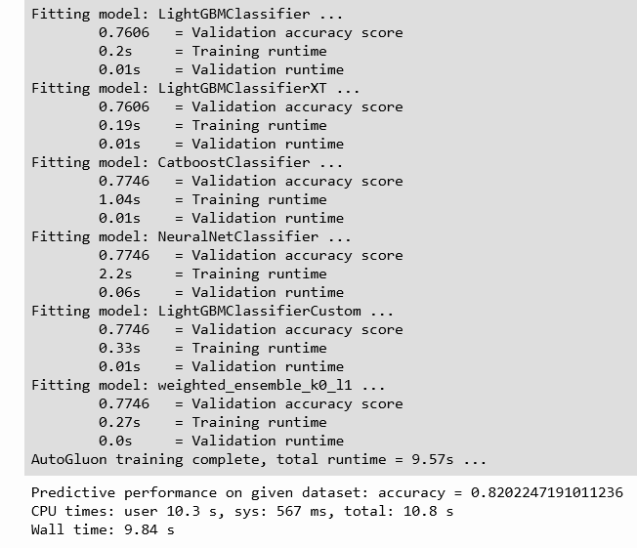
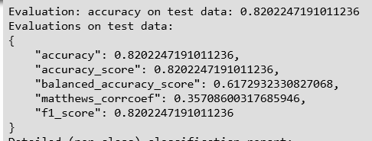
Results using AutoGluon

Slide 25
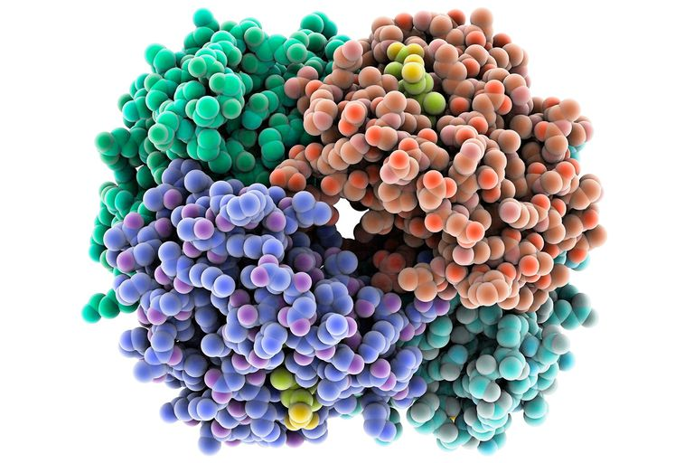
Important
Proteins

Slide 26
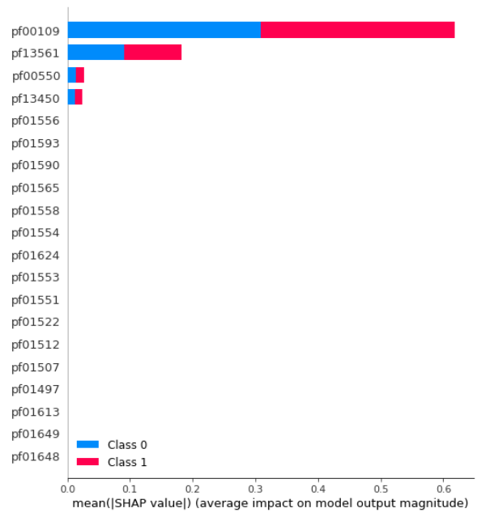
TreeSHAP using LightGBM
TreeSHAP is a fast, model-specific alternative to KernelSHAP.
Features with large absolute Shapley values are important.
Averaged the absolute Shapley values per feature across the reduced data(500 dimensions).
Notes:
What is shap?
SHAP is a united approach to explaining the output of any machine learning model. Three benefits are:
It is like the variable importance plot but it is able to show the positive or negative SHAP Values for each protein.
Each observation gets its own set of SHAP values
SHAP values can be calculated for any tree-based model. In this case we have used Xgboost.
Why do we do that?
As we discussed in the previous slides, we do that to identify the most important proteins which could help us differentiate between responders and non-responders.

Slide 27
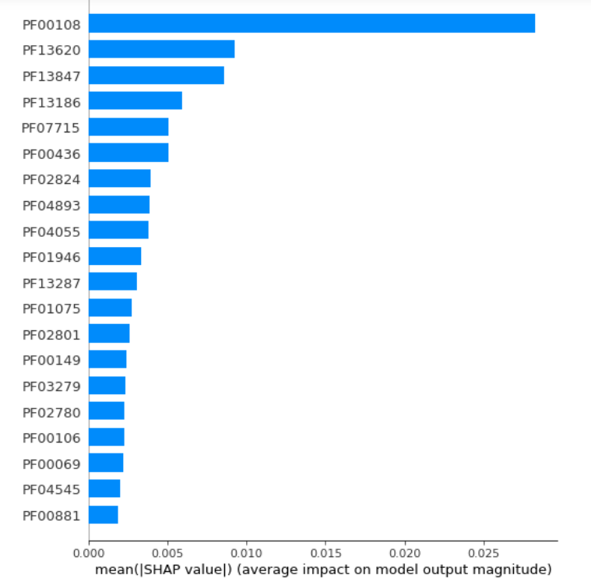
TreeSHAP using Xgboost
TreeSHAP is a fast, model-specific alternative to KernelSHAP.
Features with large absolute Shapley values are important.
Averaged the absolute Shapley values per feature across the entire data.
Notes:
What is shap?
SHAP is a united approach to explaining the output of any machine learning model. Three benefits are:
It is like the variable importance plot but it is able to show the positive or negative SHAP Values for each protein.
Each observation gets its own set of SHAP values
SHAP values can be calculated for any tree-based model. In this case we have used Xgboost.
Why do we do that?
As we discussed in the previous slides, we do that to identify the most important proteins which could help us differentiate between responders and non-responders.

Slide 28
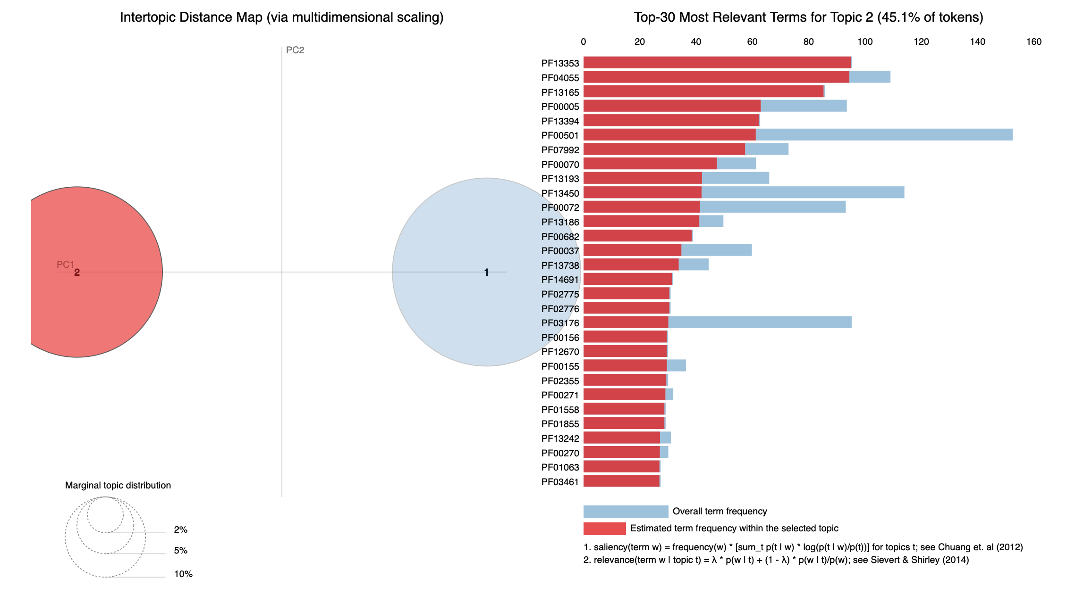
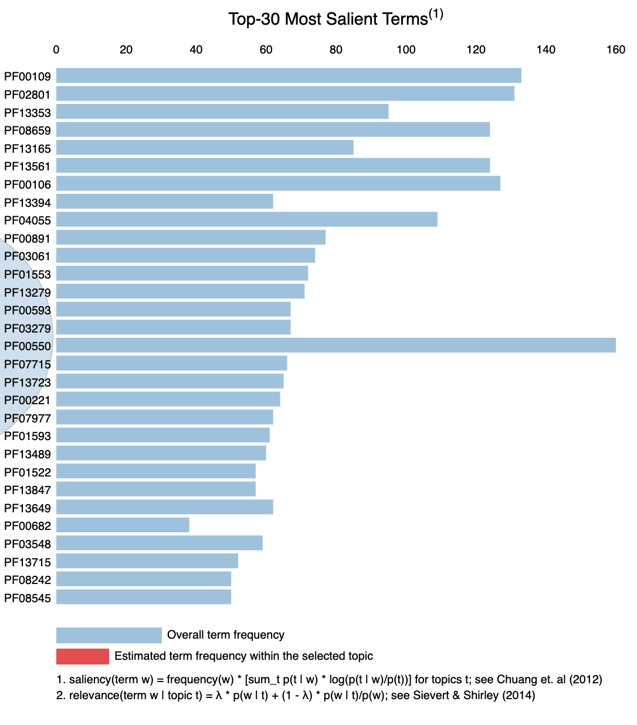
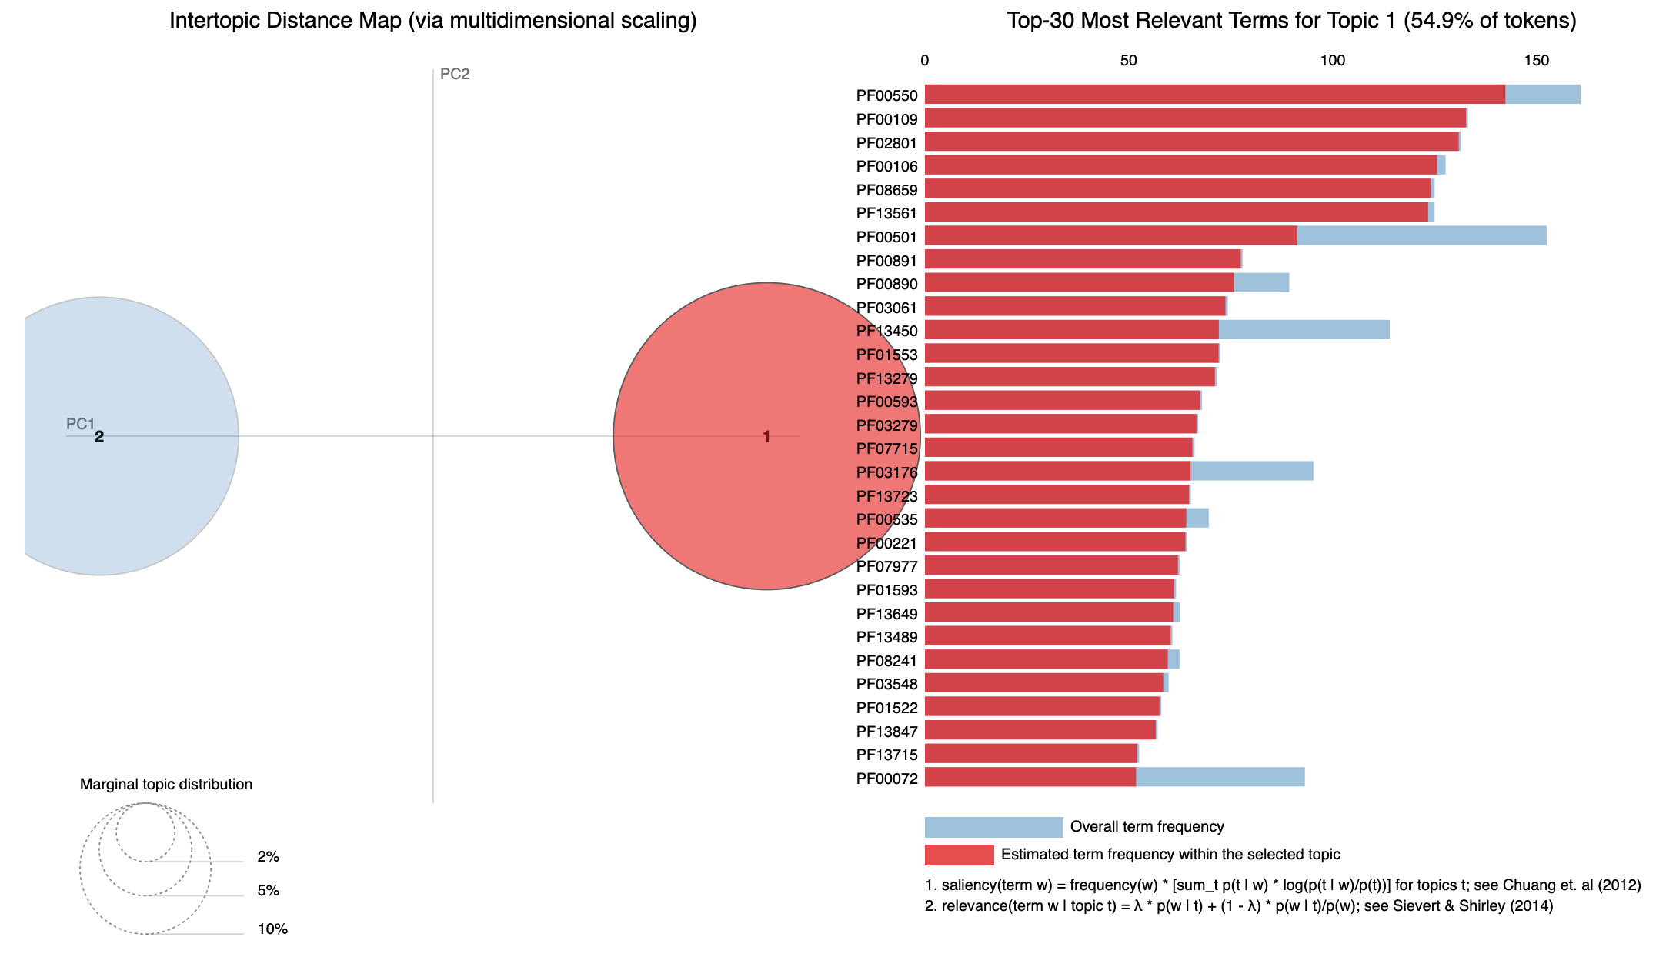
Topic Modeling
Notes:
Topic modeling is a frequently used text-mining tool for discovery of hidden semantic structures in a text body. Intuitively, given that a document is about a particular topic, one would expect particular words to appear in the document more or less frequently

Slide 29
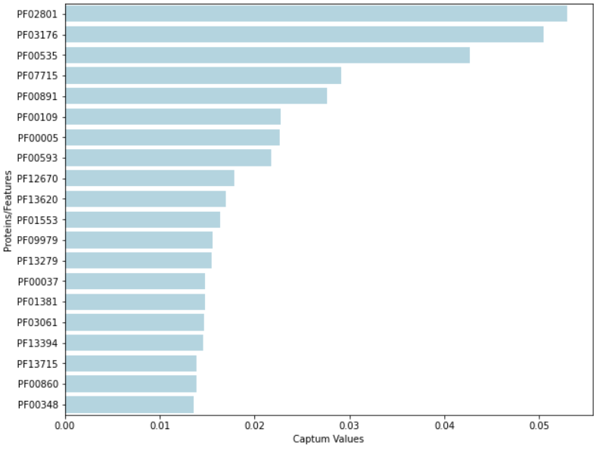
Captum
A model interpretability library for PyTorch.
Uses Integrated Gradient method to perform the feature attributions.
Compute the gradient of the output with respect to the input(features)
Feature with strongest influence on the model’s prediction gets more captum value.
Notes:
Captum is a model interpretability and understanding library for PyTorch.
Uses Integrated Gradient method to perform the feature attributions
Captum provides state-of-the-art algorithms, to provide us with an easy way to understand which proteins are contributing to a model’s output.
The output that we get from these 3 models can be sent back to the lab, which they can use to distinguish between responders and non responders.

Slide 30
Common Proteins
PF00005
PF00072
PF00106
PF00109
PF00501
PF00593
PF00702
PF00890
PF02801
PF03061
PF03176
PF03279
PF04055
PF07715
PF13186
PF13353
PF13450
PF13561
We extracted the common proteins from the output from Shap, Topic Modelling and Captum models.
These proteins may be present in the sequences of responders, non-responders or both.
The identified proteins would be sent back to the lab where the technician would research if these proteins are responsible for a patient being responsive to drugs.

Slide 31
Imbalanced Data
Insufficient Data
Not sure if the proteins are sequential
Learnings
Challenges
Learnt how to implement different approaches
How to work with real life data
Implement various techniques from research papers

Slide 32
Next Steps
01
Get more data
02
Transfer learning using Universal Sentence Embeddings(NLP)
03
BERT Large Corpus

Slide 33
Thank You!

Slide 34
References
https://github.com/slundberg/shap
https://github.com/ethen8181/machine-learning/blob/master/keras/text_classification/transformers/gensim_word2vec.py
https://christophm.github.io/interpretable-ml-book/shap.html
https://arxiv.org/abs/1408.5882
https://journals.plos.org/plosone/article?id=10.1371/journal.pone.0141287
https://towardsdatascience.com/text-classification-with-cnns-in-pytorch-1113df31e79f
https://captum.ai/tutorials/Titanic_Basic_Interpret

